Slide 1
Title Slide
Layer Rugs Website ReplicaYour Name
GLA University
Computer Engineering and Applications
02 Dec. 2023

Slide 2
Introduction
Create a replica of the Layer Rugs website using HTML, CSS, and JavaScript.
The current Layer Rugs website is not visually appealing and does not provide a user-friendly experience, which is making it difficult for the company to attract and retain customers.
The project aims to create a visually appealing and user-friendly website replica of the Layer Rugs website.

Slide 3
Objectives
Create a replica of the Layer Rugs website to improve the company's customer experience.
The current Layer Rugs website is not visually appealing or user-friendly, making it difficult to attract and retain customers.
A high-quality replica of the Layer Rugs website that is visually appealing, user-friendly, and helps the company attract and retain customers.

Slide 4
Problem Statement
Identify and solve the problem of the current Layer Rugs website not being visually appealing or user-friendly.
It is important to solve this problem because it is making it difficult for the company to attract and retain customers.

Slide 5
Literature Review
Identify and solve the problem of the current Layer Rugs website not being visually appealing or user-friendly.
Increase website traffic, conversion rate, decrease bounce rate, and get positive feedback from users.
Conduct user research, design new website, implement website, test website, and launch website.
Access to current Layer Rugs website, team of web developers, testing environment, and budget.

Slide 6
Methodology
Create a visually appealing and user-friendly replica of the Layer Rugs website.
Improve the company's customer experience by making it easier for customers to find and purchase products.
Increase website traffic, conversion rate, and decrease bounce rate.

Slide 7
System Architecture
Replicate the Layer Rugs website with improved visual appeal and user-friendliness.
Enhance customer experience to boost website traffic, conversion rates, and reduce bounce rates.
Receive positive feedback from users.

Slide 8
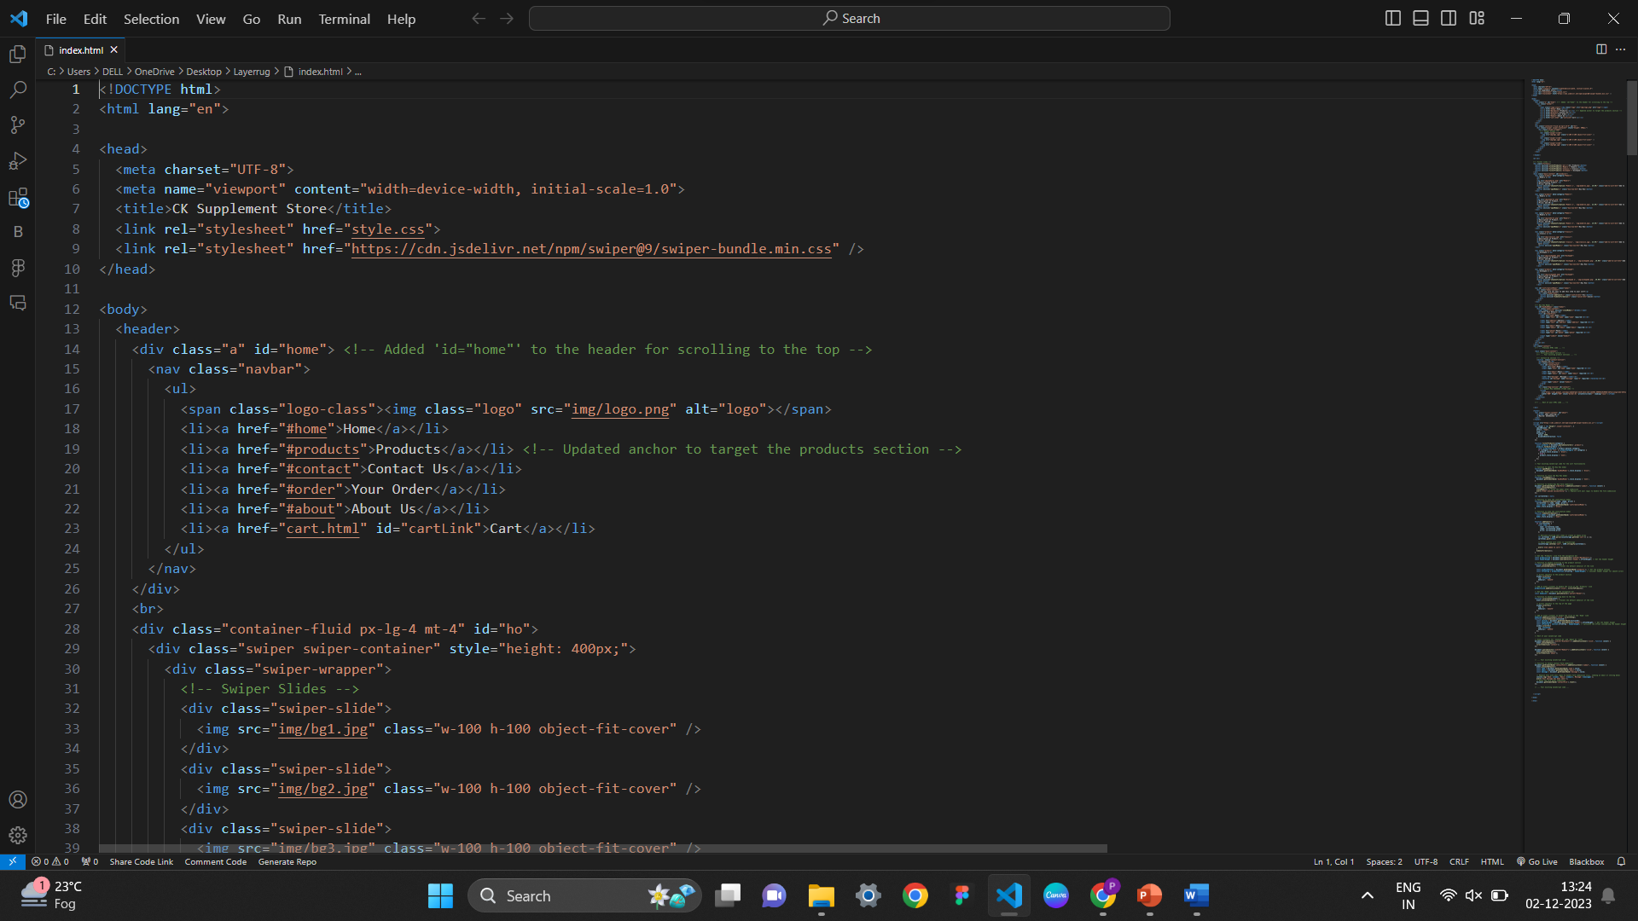
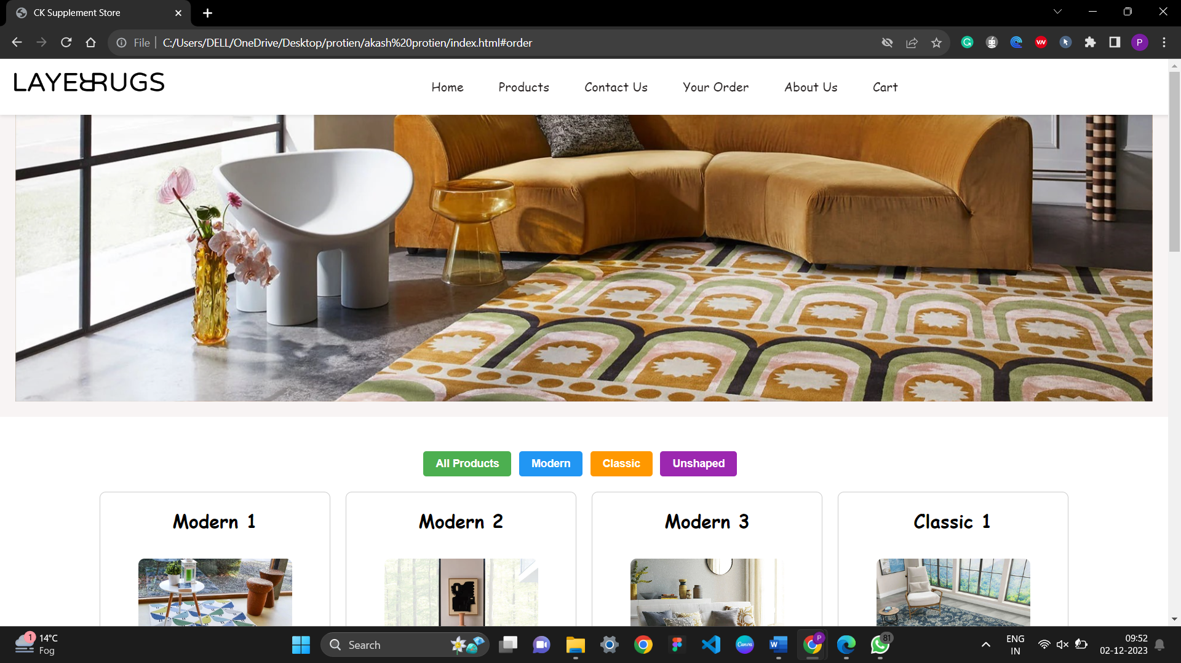
Implementation
Develop a user-friendly and visually appealing replica of the Layer Rugs website.
Improve customer experience and boost sales by increasing website traffic, conversion rates, and decreasing bounce rates.
Receive positive feedback from users by creating a website that meets their needs and expectations.

Slide 9
Features
Design and develop a visually appealing and user-friendly replica of the Layer Rugs website to improve customer experience and boost sales.
Implement features and functionalities that meet the needs and expectations of users, leading to increased website traffic, conversion rates, and reduced bounce rates.
Collect and analyze user feedback to identify areas for improvement and ensure that the website is constantly evolving to meet the needs of its users.

Slide 10
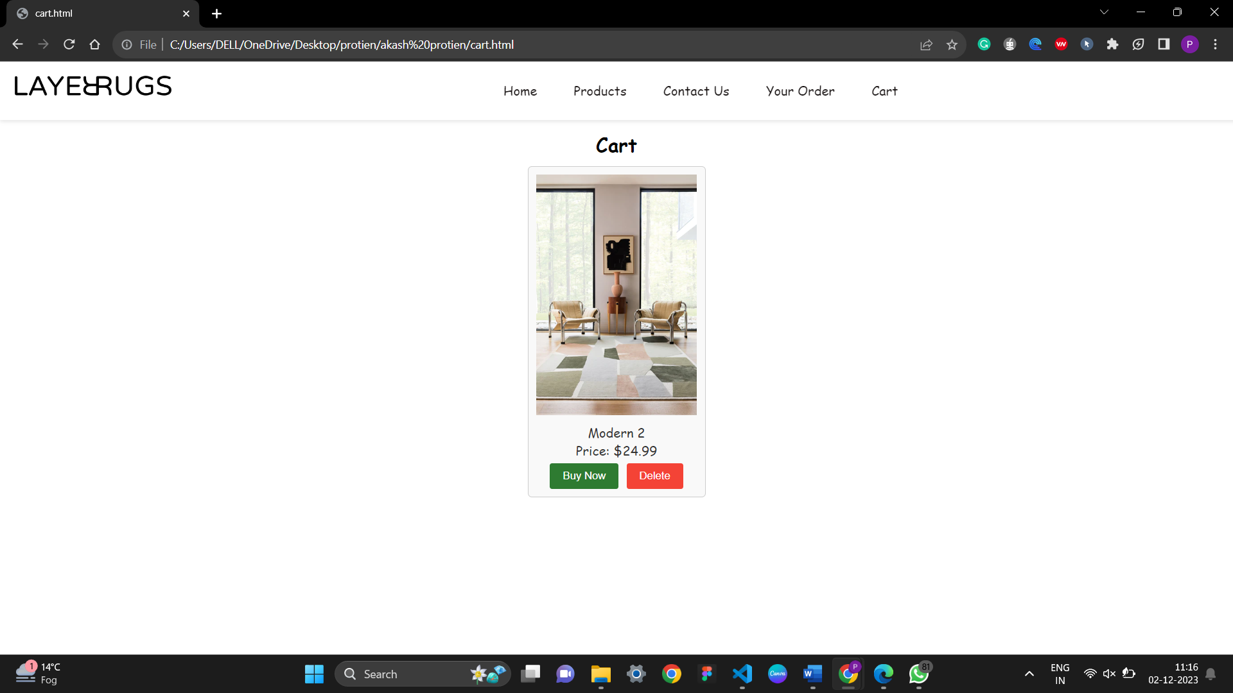
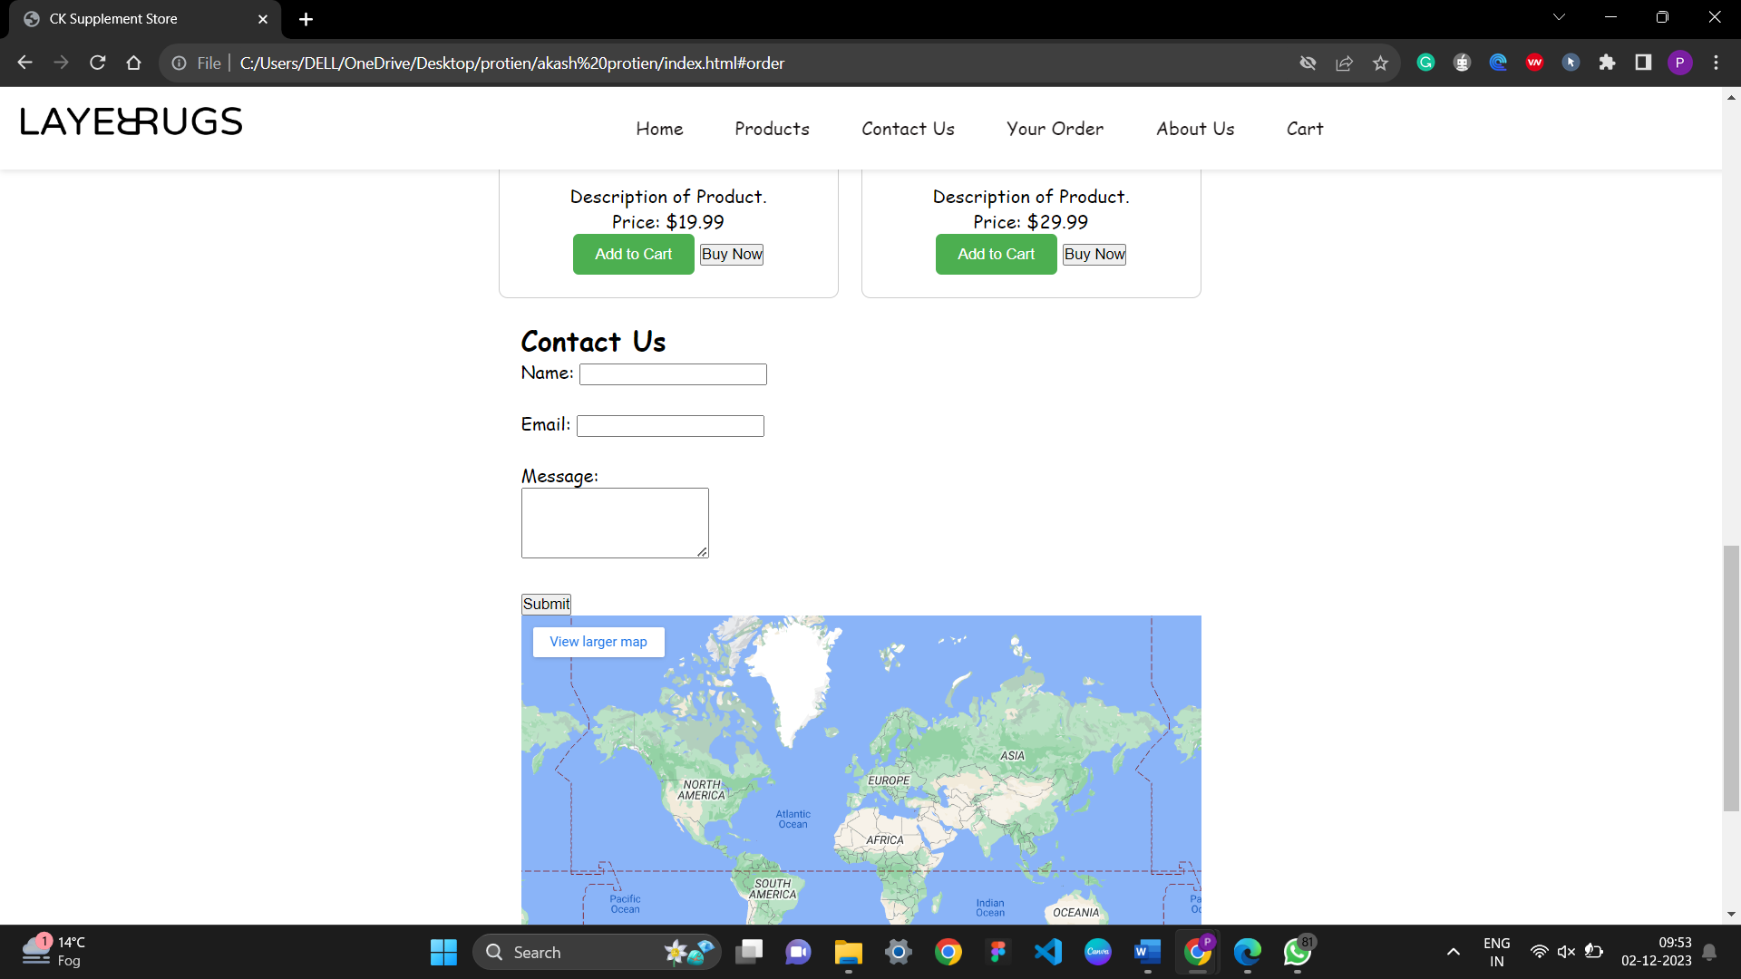
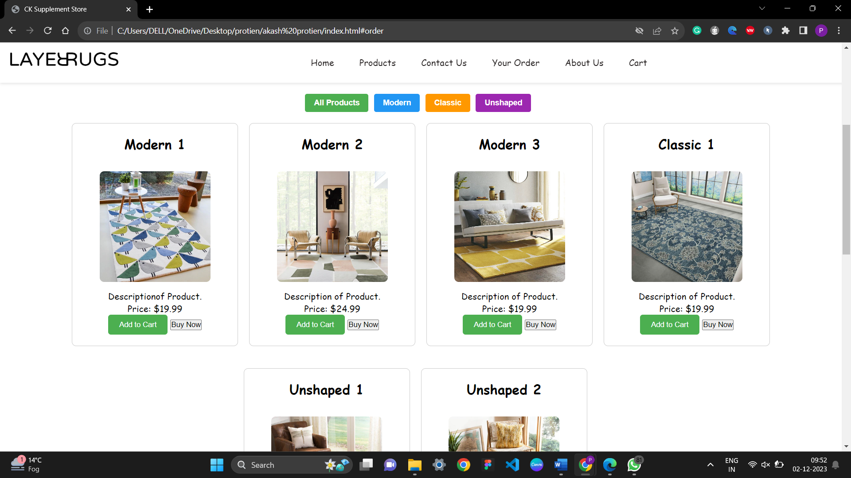
Results

Slide 11
Challenges Faced
Improve the Layer Rugs website by creating a visually appealing and user-friendly replica.
Drive business growth by increasing website traffic, conversion rates, and reducing bounce rates.
Satisfy users by meeting their needs and expectations.

Slide 12
Future Work
Redesign the Layer Rugs website to enhance user experience and boost sales.
Implement user-centric features and functionalities to increase website traffic, conversion rates, and reduce bounce rates.
Gather and analyze user feedback to continuously improve the website.

Slide 13
Conclusion
Upgrade the Layer Rugs website with a user-centric design and enhanced functionality to improve customer experience and boost sales.
Elevate the Layer Rugs website to deliver an exceptional customer experience and drive business growth.

Slide 14
Acknowledgments
Thank anyone who contributed to the project, including professors, peers, or anyone else who supported you

Slide 15
Q&A
Open the floor for questions from the audience

